Slide 1
Accounting Method
By
Gururaj
Assistant Professor-Selection Grade
Department of Computer Science & Engineering
M.I.T Manipal

Slide 2
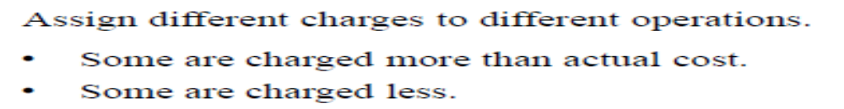
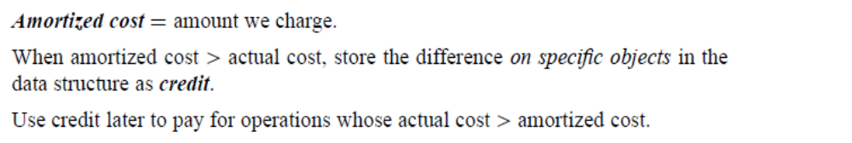
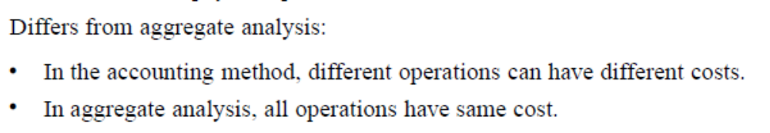
Accounting Method

Slide 3
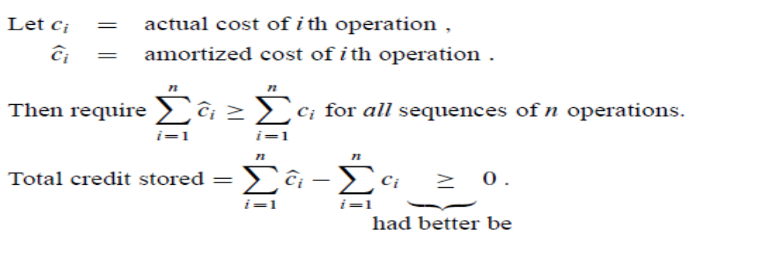
Accounting Method

Slide 4
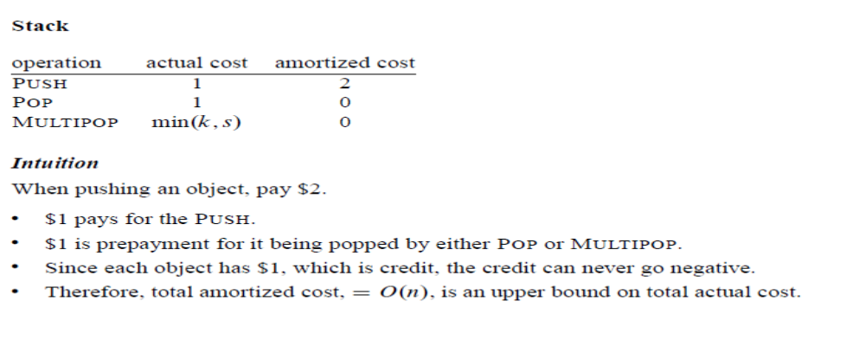
Accounting Method

Slide 5
For each operation in the sequence, we have
if the amortized cost > actual cost then the difference is stored as a credit with an object in the data structure.
if the amortized cost < actual cost then use stored credits to make up for the difference.
We have to use stored credit when amortized cost is less than actual cost to make up for the difference, so that sum of costs is always nonnegative.

Slide 6
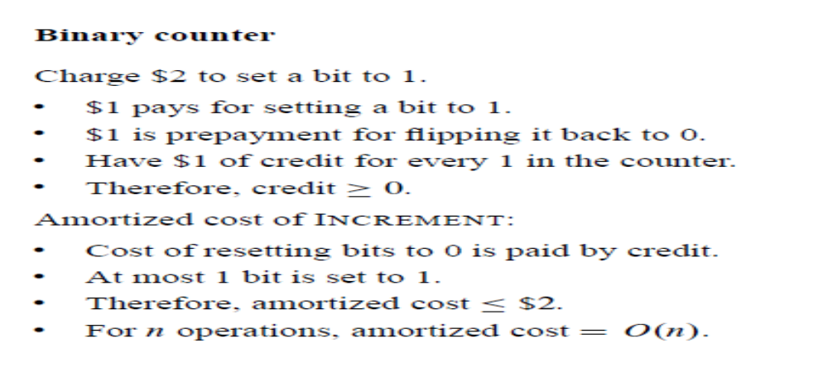
Incrementing a binary counter

Slide 7
Exercise -1
A sequence of stack operations is performed on a stack whose size never exceeds k. After every k operations, a copy of entire stack is made for backup purposes. Show that the cost of n stack operations, including copying stack is O(n) by assigning suitable amortized costs to the various stack operations.

Slide 8
Exercise-2
Suppose we wish not only to increment a counter but also reset it to zero. Show how to implement a counter as an array of bits so that any sequence of n INCREMENT and RESET operation takes time O(n) On an initially zero counter

